Slide 1
Software Engineering V
Tools
DEMO PresentAtion
David North
Assoc. Prof. of Computer Science
Oklahoma Christian University

Slide 2
SE IV – Presentation Outline
Problem
System Overview
  Main system flow (text or images)
List of required functions by user
  Indicate what is completed
Screen hierarchy
ERD
Lessons learned
Demo

Slide 3
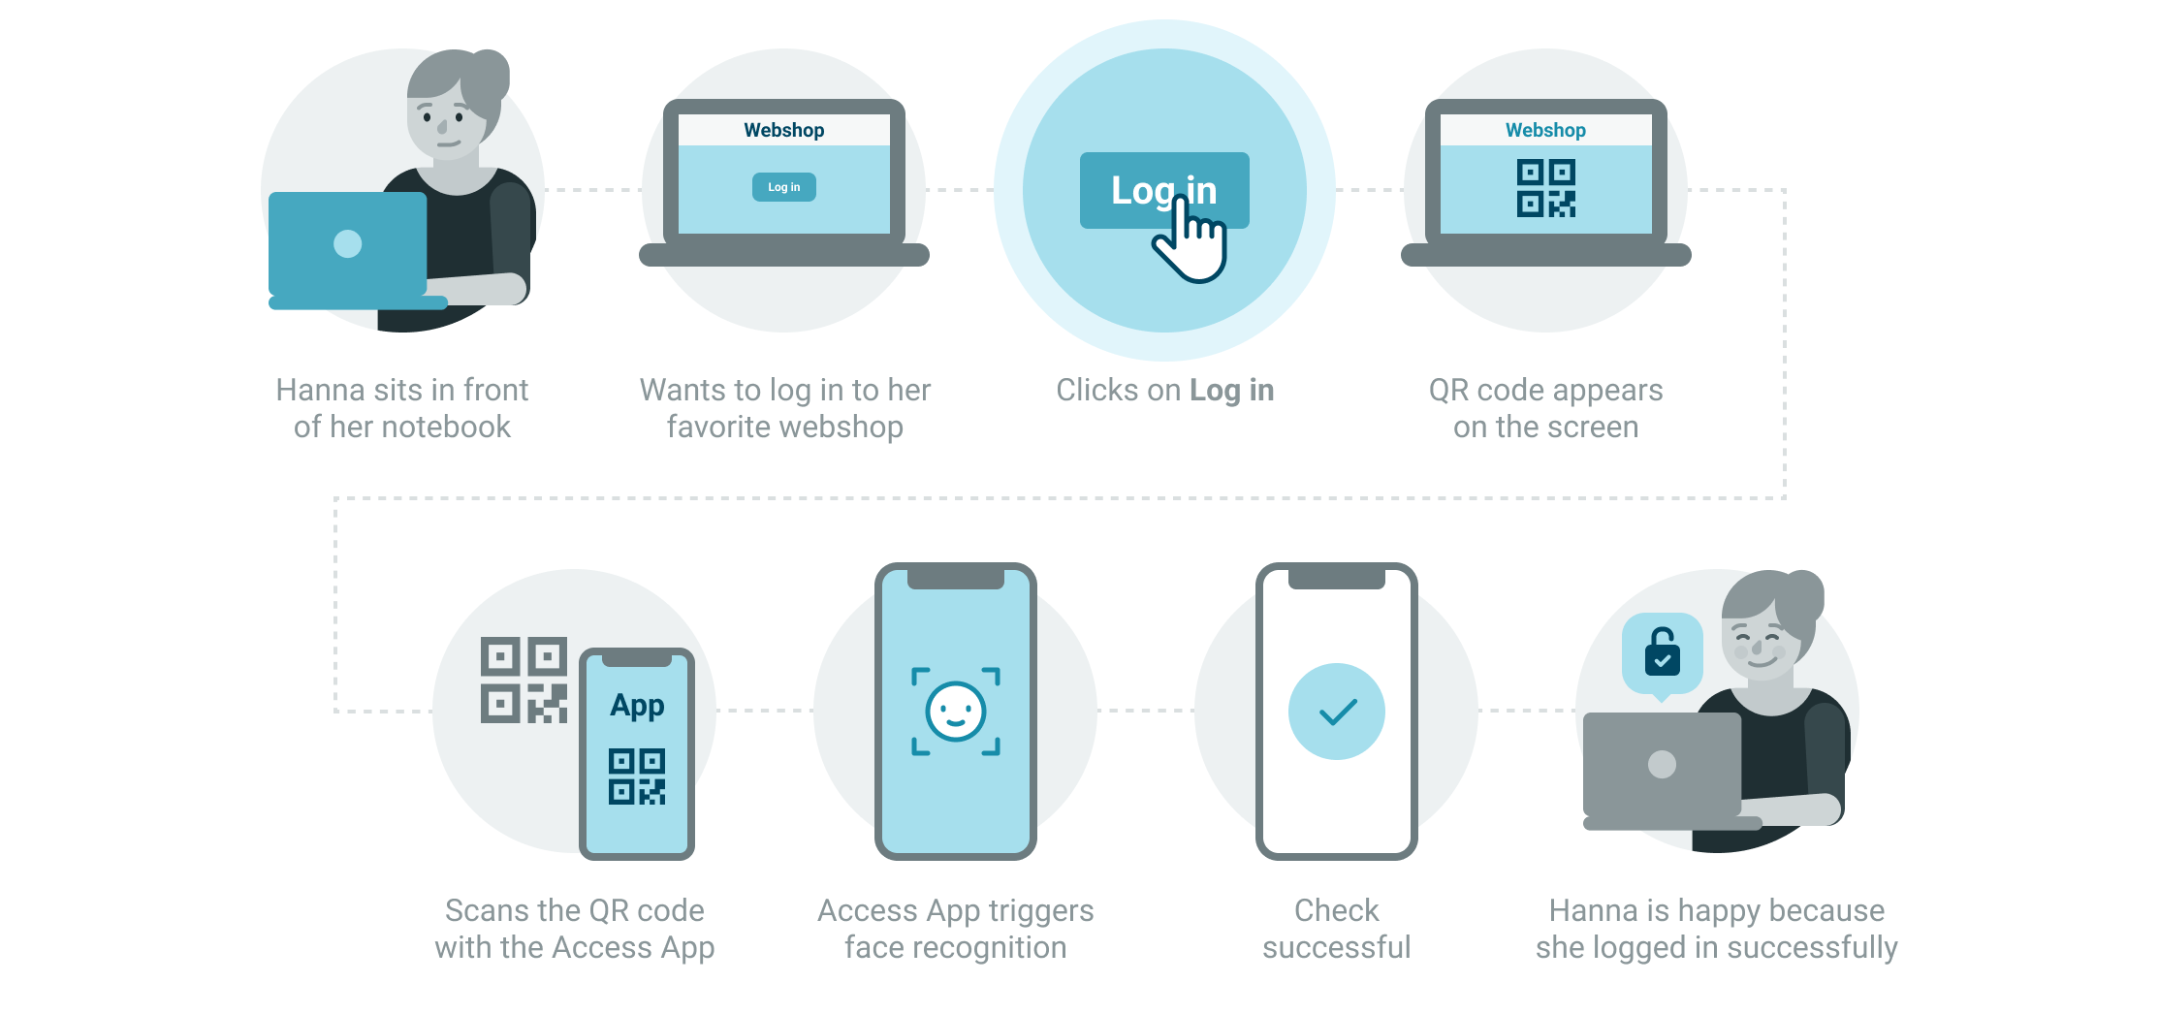
SE IV – System Flow

Slide 4
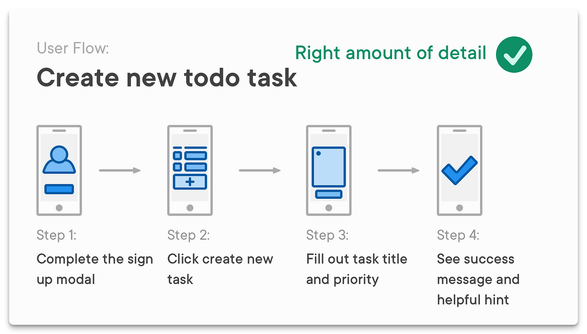
SE IV – System Flow

Slide 5
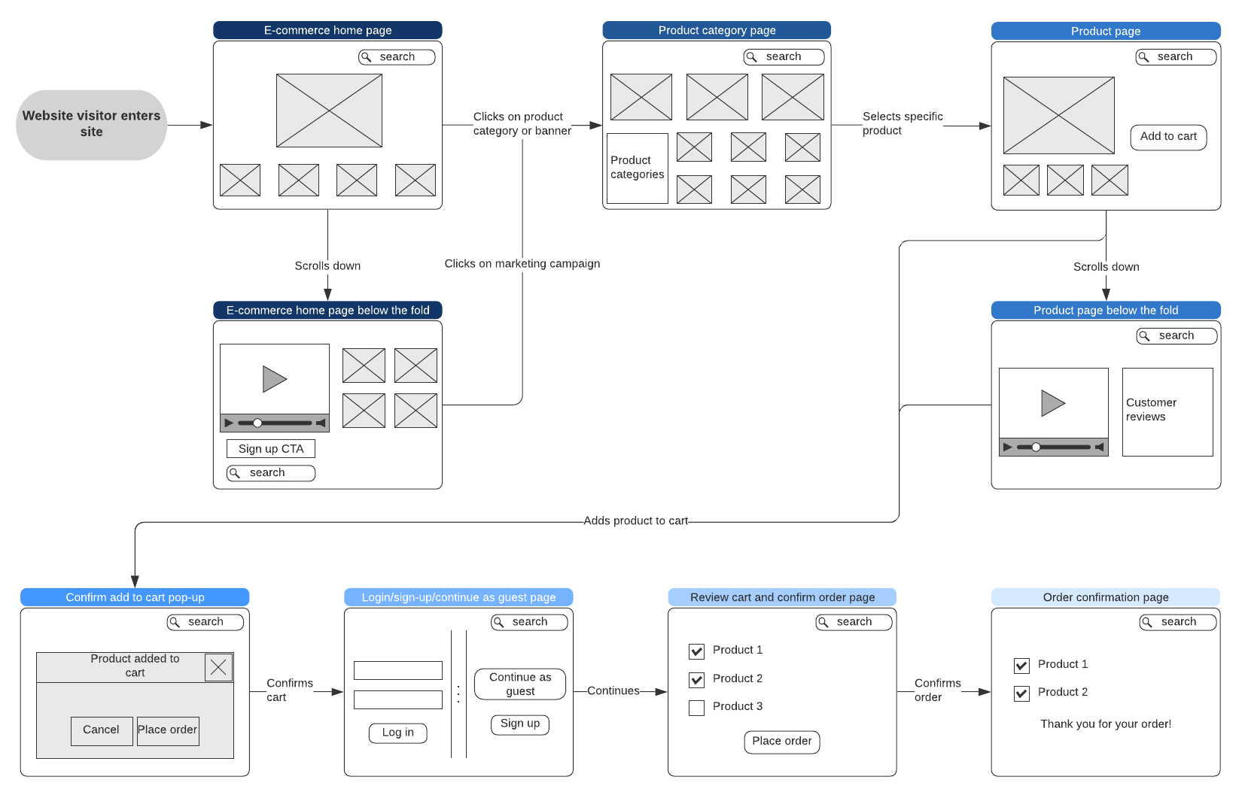
SE IV – system flow

Slide 6

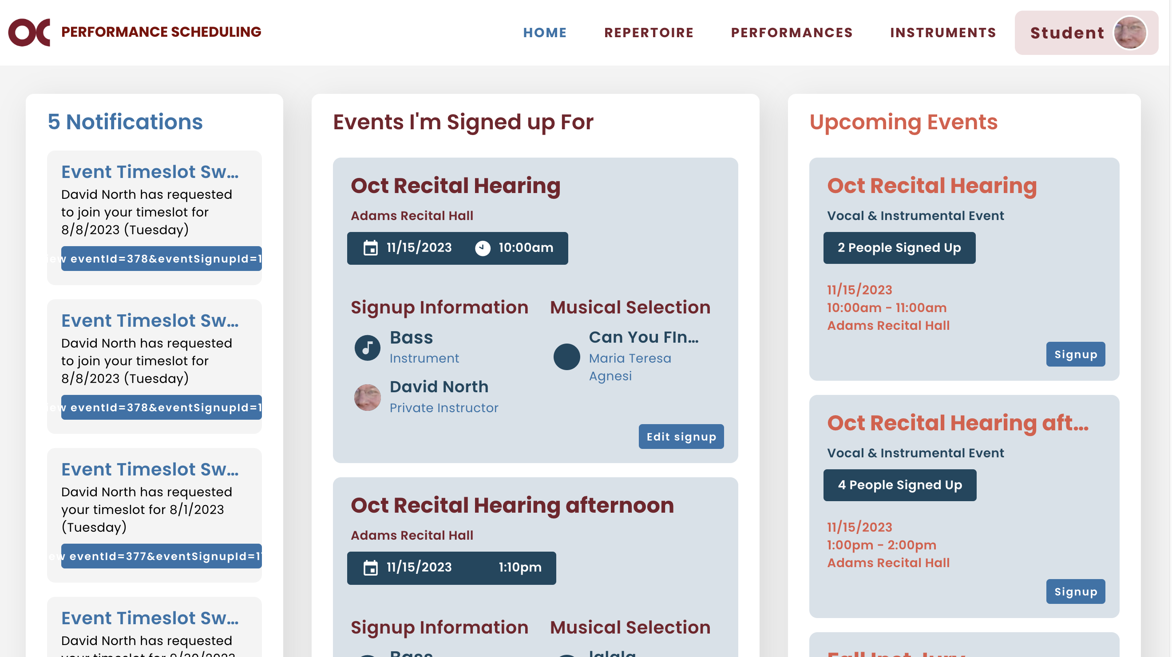
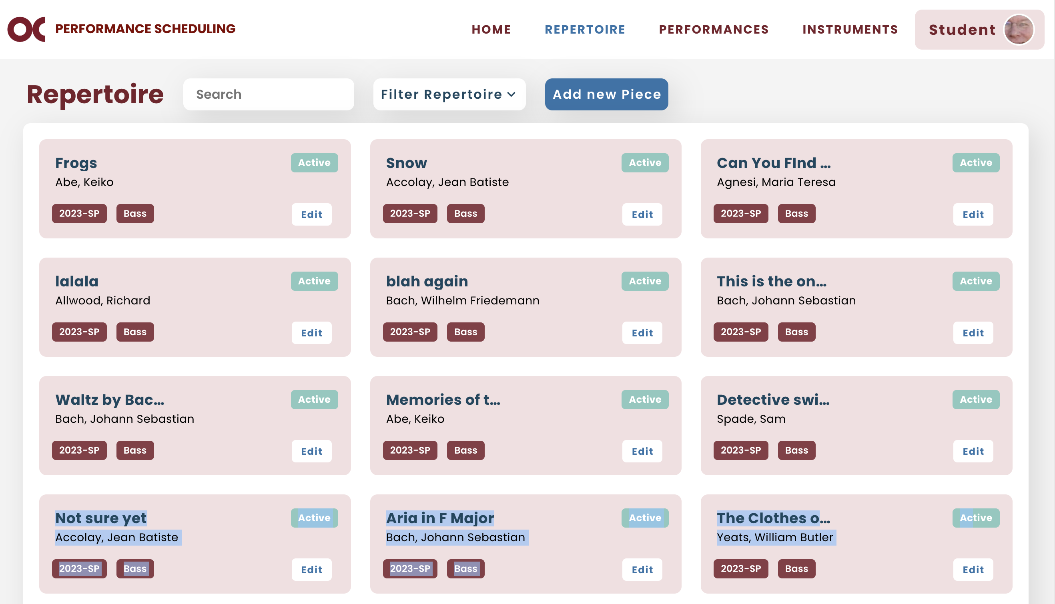
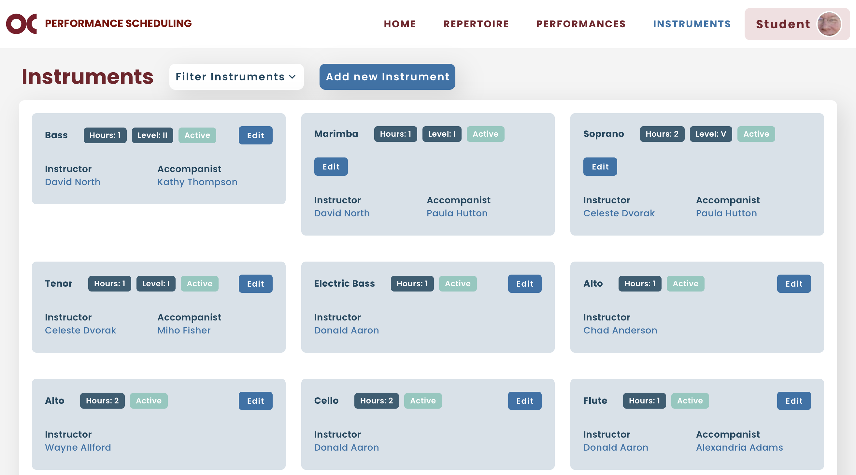
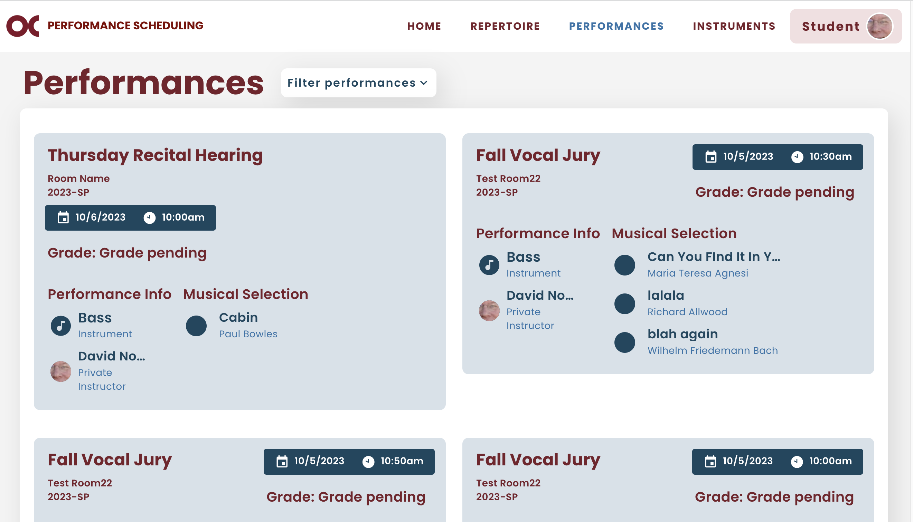
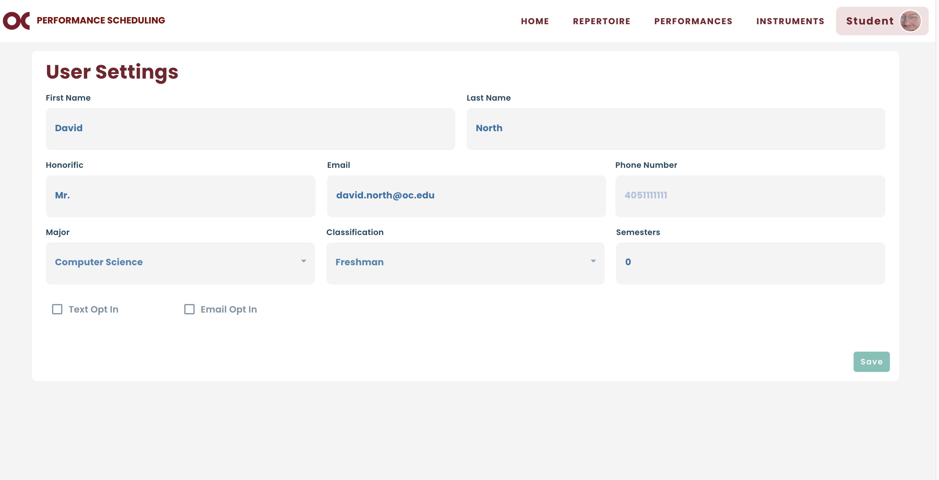
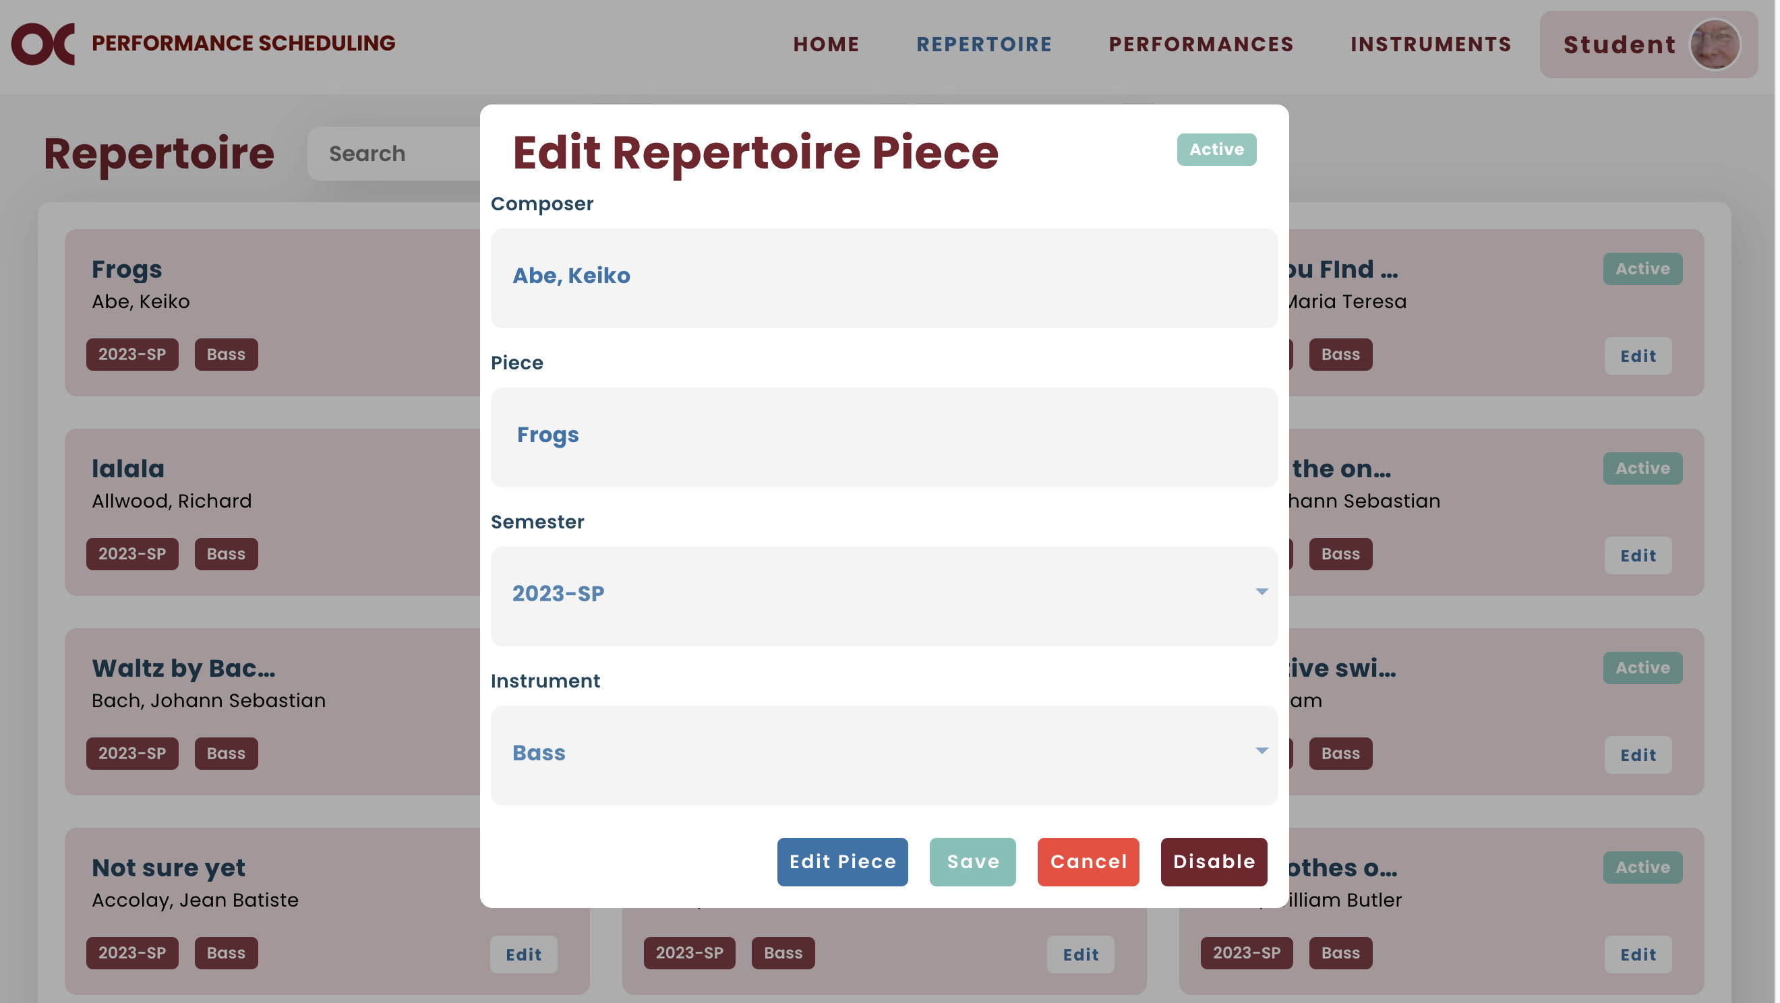
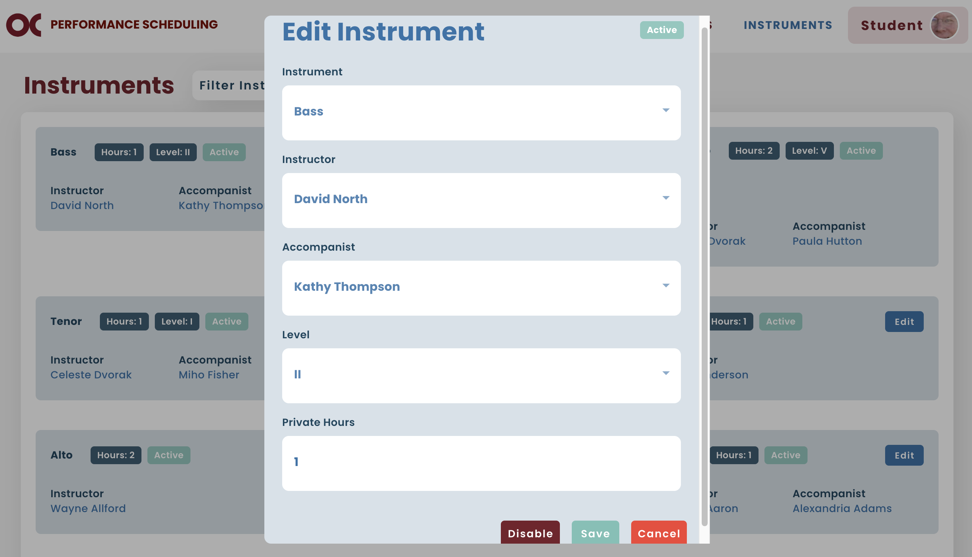
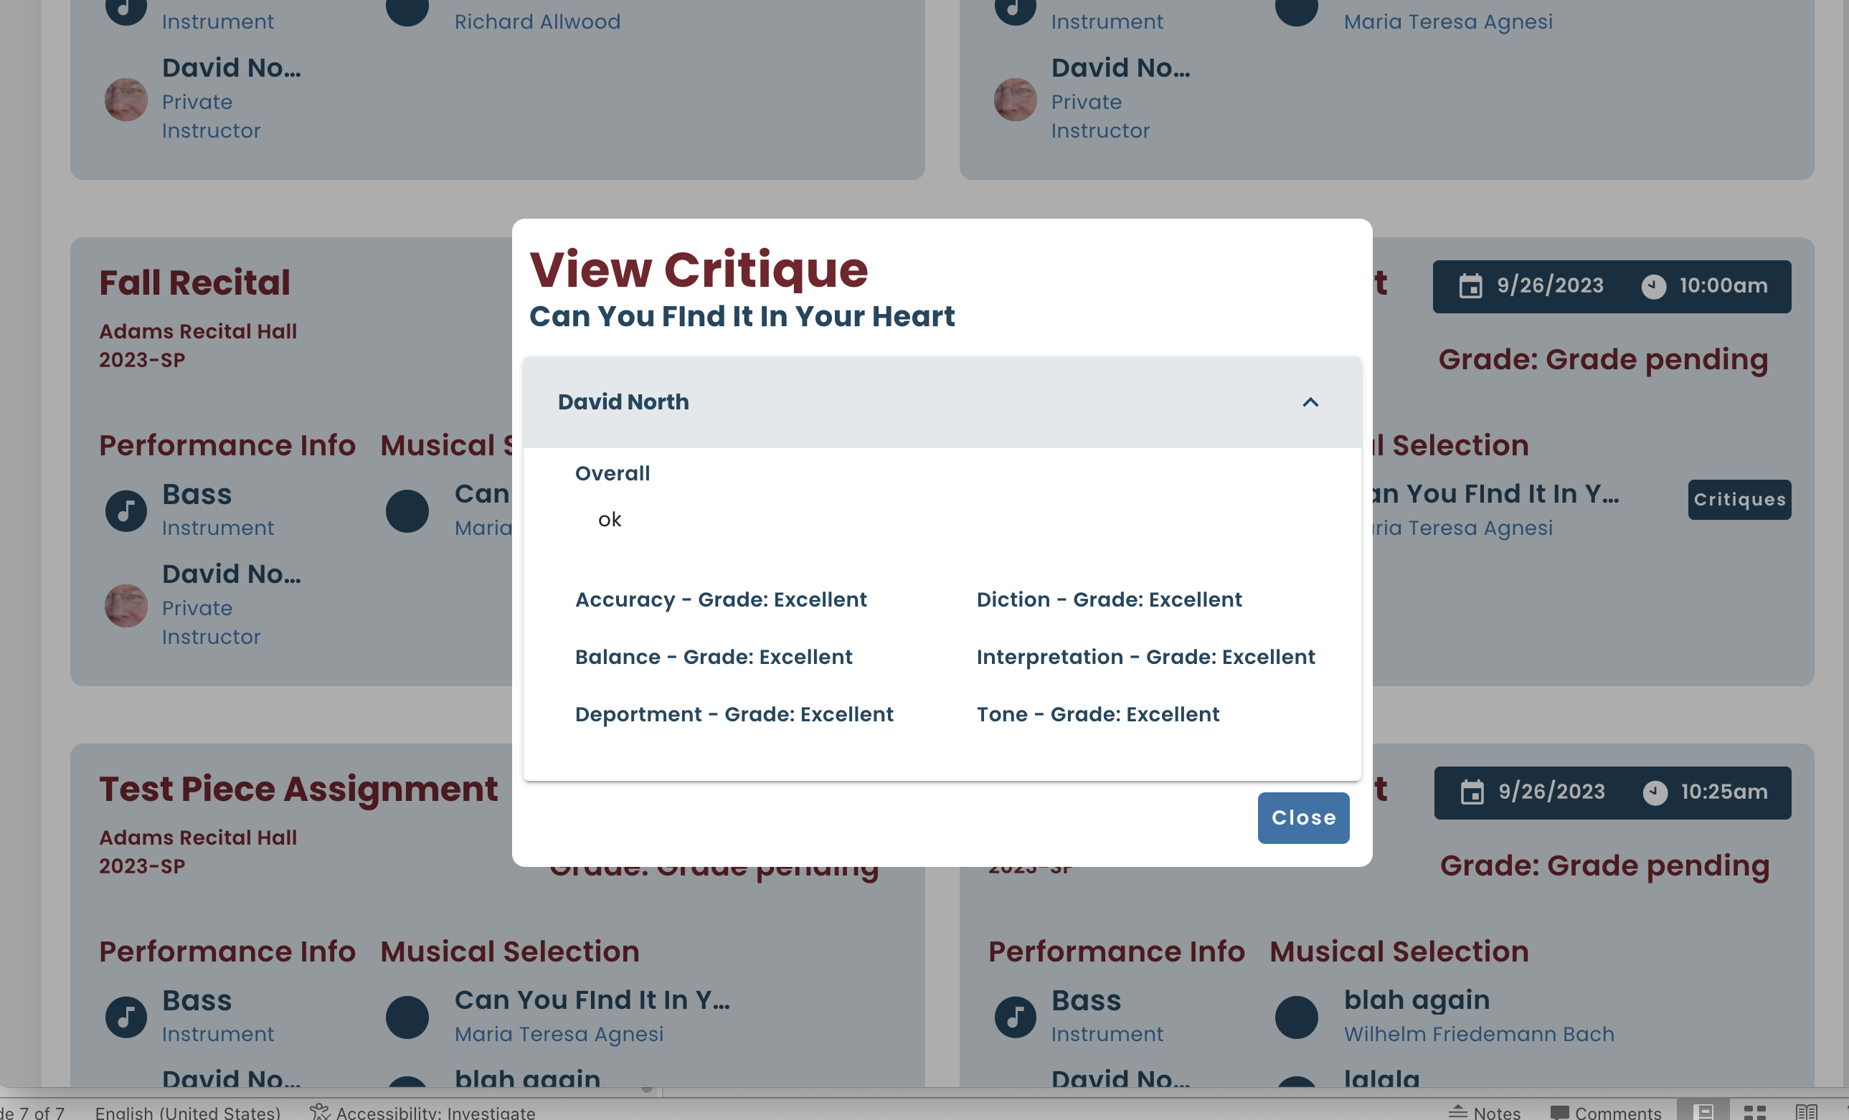
SE IV – Screen Hierarchy
Login
Home
Repertoire
Instruments
Performances w/Critique
User Settings
Instruments

Slide 7
SE IV – Slide Notes
Slides
  Logical sequence
  Not too much content
  Readable
    High contrast
    Font Size (21)
      Sub Point (18 )

Slide 8
SE IV – Demo Notes
Demo
  Have a plan
  Have good sample data
  Demo process
    Show how each user can do their main functions

